Slide 1
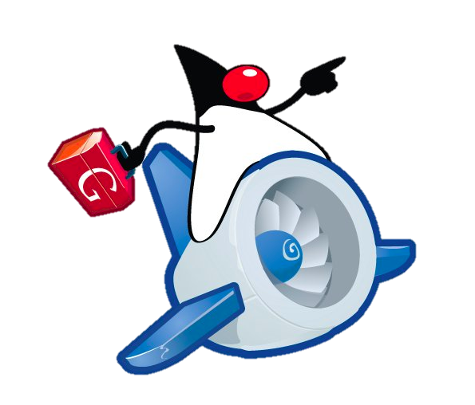

Google App Engine
www.supinfo.com
Copyright © SUPINFO. All rights reserved
Notes:
[Title of the course]
Nov 8, 2008
Copyright © 2004-2005 NameOfTheOrganization. All rights reserved.
1
© SUPINFO International University - http://www.supinfo.com
SUPINFO vous permet de partager ce document
Vous êtes libre de :
Partager — reproduire, distribuer et communiquer ce document Remixer — modifier ce document
A condition de respecter les règles suivantes :
Indication obligatoire de la paternité — Vous devez obligatoirement préciser l’origine « SUPINFO » du document au début de celui-ci de la même manière qu’indiqué par SUPINFO International University – Notamment en laissant obligatoirement la première et la dernière page du document, mais pas d'une manière qui suggérerait que SUPINFO International University vous soutiennent ou approuvent votre utilisation du document, surtout si vous le modifiez. Dans ce dernier cas, il vous faudra obligatoirement supprimer le texte « SUPINFO Official Document » en tête de page et préciser notamment la page indiquant votre identité et les modifications principales apportées.
En dehors de ces dispositions, aucune autre modification de la première et de la dernière page du document n’est autorisée.
NOTE IMPORTANTE : Ce document est mis à disposition selon le contrat CC-BY-NC-SA Creative Commons disponible en ligne http://creativecommons.org/licenses ou par courrier postal à Creative Commons, 171 Second Street, Suite 300, San Francisco, California 94105, USA modifié en ce sens que la première et la dernière page du document ne peuvent être supprimées en cas de reproduction, distribution, communication ou modification. Vous pouvez donc reproduire, remixer, arranger et adapter ce document à des fins non commerciales tant que vous respectez les règles de paternité et que les nouveaux documents sont protégés selon des termes identiques. Les autorisations au-delà du champ de cette licence peuvent être obtenues à support@supinfo.com.
© SUPINFO International University – EDUCINVEST - Rue Ducale, 29 - 1000 Brussels Belgium . www.supinfo.com

Slide 2


Google App Engine
Course objectives
By completing this course, you will be able to :
Build an App Engine application using standard Java web technologies
Create an App Engine Java project with Eclipse
Use the Google Plugin for Eclipse for App Engine development
Use the App Engine datastore with JPA
Upload your app to App Engine
Notes:
[Title of the course]
Nov 8, 2008
Copyright © 2004-2005 NameOfTheOrganization. All rights reserved.
2

Slide 3

Google App Engine
Course topics
Course’s plan
Introduction
Installing the GAE/Java SDK
GAE / Java Environement
Creating a Project
JPA with GAE/Java
Run
Deploy
Restrictions
Example
Notes:
[Title of the course]
Nov 8, 2008
Copyright © 2004-2005 NameOfTheOrganization. All rights reserved.
3

Slide 4

Google App Engine
Introduction
Google App Engine is a cloud computing solution for web applications
Platform as a Service (PaaS)
Virtualize applications across multiple servers
Automatic scaling for web applications
More requests ➔ More allocates resources
Google App Engine applications can currently be written in :
Java, Python or Go
Free up to a certain level of consumed resources
Perfect to us ! ☺
Notes:
[Title of the course]
Nov 8, 2008
Copyright © 2004-2005 NameOfTheOrganization. All rights reserved.
4

Slide 5
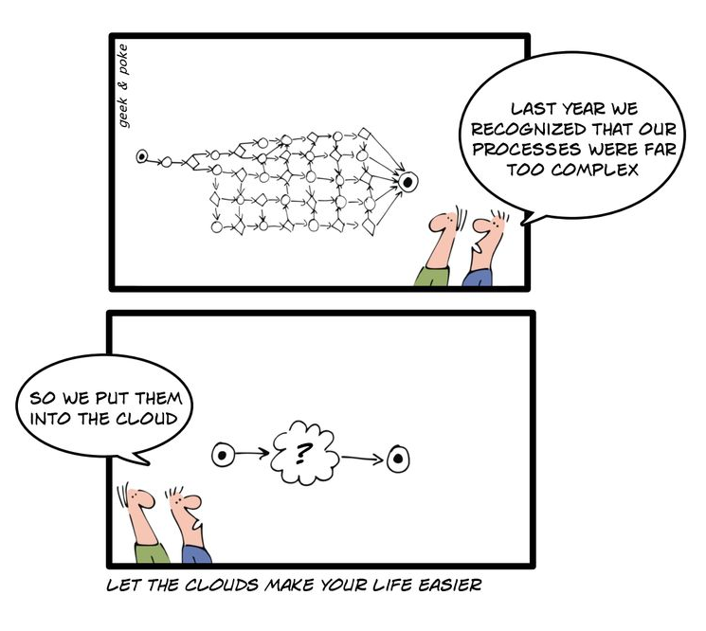
Google App Engine
Introduction
Notes:
[Title of the course]
Nov 8, 2008
Copyright © 2004-2005 NameOfTheOrganization. All rights reserved.
5

Slide 6
Google App Engine
Installing the GAE/Java SDK
GAE supports Java 5 and Java 6
Need to install the JDK !
Google provide a GAE plugin for Eclipse to develop, test and deploy apps
Software Update site is :
http://dl.google.com/eclipse/plugin/{eclipse_version} where {eclipse_version} is the version number of your Eclipse
Example for Helios :
http://dl.google.com/eclipse/plugin/3.6
Notes:
[Title of the course]
Nov 8, 2008
Copyright © 2004-2005 NameOfTheOrganization. All rights reserved.
6

Slide 7
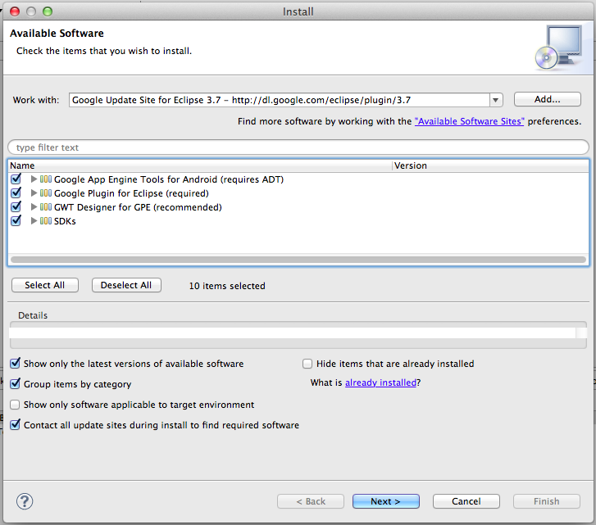
Google App Engine
Installing the GAE/Java SDK
Notes:
[Title of the course]
Nov 8, 2008
Copyright © 2004-2005 NameOfTheOrganization. All rights reserved.
7

Slide 8
Google App Engine
GAE/Java Environment
GAE/Java use the Java Servlet specification for interacting with the web server environment
Currently, only the version 2.5 is supported
Relational database aren’t available on GAE
Use a NoSQL data store (BigTable)
To access to the data store, two API are available :
JDO (Java Data Object)
JPA (Java Persistence API)
Notes:
[Title of the course]
Nov 8, 2008
Copyright © 2004-2005 NameOfTheOrganization. All rights reserved.
8
More about NoSQL here: http://blog.xebia.fr/2010/04/21/nosql-europe-tour-dhorizon-des-bases-de-donnees-nosql/
More about JDO here: http://db.apache.org/jdo/

Slide 9
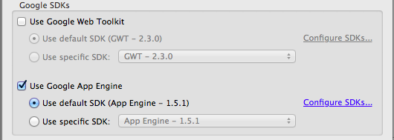
Google App Engine
Creating a Project
When the Google plugin is installed
You can create a Google Web Application Project
Just follow the wizard and check “Use Google App Engine”
You can uncheck “Use Google Web Toolkit”
Notes:
[Title of the course]
Nov 8, 2008
Copyright © 2004-2005 NameOfTheOrganization. All rights reserved.
9
More about GWT here: http://code.google.com/webtoolkit/

Slide 10
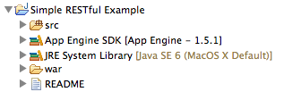
Google App Engine
Creating a Project
A Google Web Application is composed of three parts :
The src folder where to put the source code files
The Java and App Engine Libraries
The war folder where to put your HTML and JSP pages
Contains also the WEB-INF directory !
Notes:
[Title of the course]
Nov 8, 2008
Copyright © 2004-2005 NameOfTheOrganization. All rights reserved.
10

Slide 11
Google App Engine
JPA with GAE/Java
To use JPA you need a persistence.xml file
To work on Google App Engine, your file must contain the following Persistence Unit declaration :
...
<persistence-unit name="restful-example">
<provider>
org.datanucleus.store.appengine.jpa.DatastorePersistenceProvider
</provider>
<properties>
<property name="datanucleus.NontransactionalRead" value="true" />
<property name="datanucleus.NontransactionalWrite" value="false" />
<property name="datanucleus.ConnectionURL" value="appengine" />
</properties>
</persistence-unit>
...
Notes:
[Title of the course]
Nov 8, 2008
Copyright © 2004-2005 NameOfTheOrganization. All rights reserved.
11

Slide 12
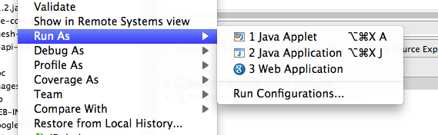
Google App Engine
Run as Google Web App
To test locally your project, you can start a GAE environment on your computer
To do that, select your application and select :
Run As → Google Web Application
Notes:
[Title of the course]
Nov 8, 2008
Copyright © 2004-2005 NameOfTheOrganization. All rights reserved.
12

Slide 13
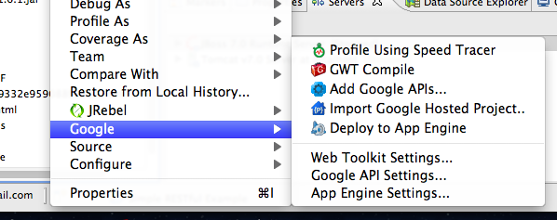
Google App Engine
Deploy on Google App Engine
When your project is ready, you can deploy it on Google App Engine
To do that, select your application and select :
Google → Deploy to App Engine
Notes:
[Title of the course]
Nov 8, 2008
Copyright © 2004-2005 NameOfTheOrganization. All rights reserved.
13

Slide 14
Google App Engine
Restrictions
Google App Engine have some restrictions :
Read-only access to the filesystem
Java applications may only use a subset of the classes from Java SE
Look at the JRE Class White List to more information
Java applications cannot create new threads
Datastore cannot use inequality filters on more than one entity property per query
A process started on the server to answer a request can’t last more than 30 seconds
…
Notes:
[Title of the course]
Nov 8, 2008
Copyright © 2004-2005 NameOfTheOrganization. All rights reserved.
14
JRE Class White List: http://code.google.com/appengine/docs/java/jrewhitelist.html
List of GAE restrictions: http://en.wikipedia.org/wiki/Google_App_Engine#Restrictions

Slide 15

Google App Engine
Google App Engine Example
Do you remember of the Simple Restful Example webapp ?
This application is deployed on Google App Engine…
… and the source code is publicly available on GitHub !
➔ https://github.com/bargenson/Simple-RESTful-Example
Notes:
[Title of the course]
Nov 8, 2008
Copyright © 2004-2005 NameOfTheOrganization. All rights reserved.
15

Slide 16


Google App Engine
Stop-and-think
Do you have any questions ?
Notes:
[Title of the course]
Nov 8, 2008
Copyright © 2004-2005 NameOfTheOrganization. All rights reserved.
16
16

Slide 17


Exercise
REST Web Services
Create a new Google Web Application :
Copy / Paste the classes of your REST Web Service application
Refactor them to deploy your web services in the clouds !

Slide 18

Course summary
Google App Engine
What is Google App Engine
Install the SDK
Create a Project
Deploy to GAE
Restrictions

Slide 19


The End
Google App Engine

